Slide 1


SAP UI5 & FIORI with OData TRAINING
Anubhav Oberoy & Shekhar Vedi
Day – 23

Slide 2

Agenda – Day 23
Use case
Fit-to-Standard Workshop
Phase 1
Fiori App Recommendations
Guide to decide – when to go custom fiori app
UI5 Runtime Package in Software downloads
Custom Fiori App - Troubleshooting
Tools
Issues – Catalog and Group / Tile Errors
Issues – Catalog and Group
Translation
Theme Designer

Slide 3



Use case
You have recently joined as a FIORI SECURITY consultant to one of S/4HANA project Running @Anubhavtrainings.com
In the company, we have several departments like SALES, HR, Finance, Marketing.
You have been invited by Sales department to solve their challenge and needs of Fiori apps needed at different levels in organization.
Before you joined there was a SAP Fiori Security consultant in the team, who simply granted the template role access to the users as it is delivered by SAP. Though all the required apps by sales team are accessible but they are only using hardly 23% of the apps granted to them. The goal is to optimize the launchpad for sales department (which includes sales representative and sales manager). We need to adjust the SAP Fiori Launchpad content as per below requirement
Sales Representative
Sales Manager
ALEX
NOLAN
ZATS_BR_SALES_REP - ZATS_BC_EMPLOYEE
ZATS_BR_SALES_MGR – ZATS_BC_MANAGER
Sales
Inquiry
quotation
Manage SO
ZATS_BCG_SALES_EMP
Manage SO
Analyze SO fulfilment
Sales Manage
ZATS_BCG_SALES_MGR
Create leave req
My Timesheet
Create leave req
My Timesheet
My Inbox
MSS
ESS
ZATS_BCG_EMPSS
ZATS_BCG_MGRSS
Portal website
ZATS_BC_PORTAL
ZATS_BCG_PORTAL
Portal website
www.anubhavtrainings.com

Slide 4
Fit-to-Standard Workshop
It is a workshop/meeting with the set of stakeholder in the company to understand and clarify the scope of implementation of Fiori Apps Adoption.
Goal – To identify the most relevant functionality/Roles and Fiori Apps which your company needs to implement. The outcome is the set of roles which needs to be activated later one by Fiori Rapid Activation.
Participants
Delivery Managers, Business Consultants, Functional Consultant, Scrum Leads, technical Consultants, Architects and Security Team
Phase 1: Identify the Roles related to classical ECC tcodes
1.1 Find the names of the Tcodes which are part of MOST USED ROLES
1.2 The most used tcodes from usage profile
1.3 Combine the most used and most assigned tcodes
1.4 Remove the duplicates, and also the obsolete tcode (S/4HANA is system conversion)
1.5 Identify corresponding Fiori Apps related to these tcodes
Phase 2: Find the lighthouse scenario
Phase 3: Check most important business processes in the company and find the roles for the same
Phase 4: Combine these roles – That becomes the scope
Phase 5: Plan for residuals
www.anubhavtrainings.com

Slide 5
Phase 1
Top assigned Tcodes
Most assigned roles in the company
SELECT TOP 23 AGR_NAME, COUNT(AGR_NAME) FROM AGR_USERS GROUP BY AGR_NAME ORDER BY COUNT(AGR_NAME) DESC
2. Find the Tcodes which are part of these roles (ECC)
GO to SE11/SE16N and open table AGR_1251, search object type as S_TCODE and pass all role names selected from previous step. ➔ Top Assigned tcode
Top Used Tcode
Which are all the MOST used tcode in the system last month – usage statistics – ST03N ➔ TOP used
Remove the Tcodes which are removed in S/4HANA
SYCM – Simplification Database → Obsolete Tcode
Top Assigned + Top Used – Obsolete Tcode = Final Set of TCODE scope
We need to run a tool called Fiori App Recommendation Tool provided by SAP, which guide us about which Apps are required to be executed for classical tcode. To Run this tool we have 2 pre-requisites
Usage profile – Tcode
System Profile in which you are searching recommendation (S/4HANA) – ABAPProfile.xls
[option] HANA system profile – HANAProfile.xls -- select * from "_SYS_REPO"."DELIVERY_UNITS“ WHERE vendor = 'sap.com’
Extract All the Roles for these Fiori Apps
www.anubhavtrainings.com

Slide 6
Fiori App Recommendations
For Each Tcode used in your company, the tool will provide recommendation
Star 1 – Relevant Match
Star 2 – Broad Match
Star 3 - Best Match
Goal - Ultimate goal is to find the Roles which are required to activate these apps.
Phase 2:
Directly look at the BPD (rapid.sap.com) and extract the roles from those documents
Phase 3:
Directly to Fiori App Reference Library and Select Roles Which are required in your company
www.anubhavtrainings.com

Slide 7
Guide to decide – when to go custom fiori app
Is the SAP Fiori App Available in FIORI App Ref. Library
YES
NO
Perfect Fit
Mobile Required
YES
NO
YES
NO
Out-of-box usage
Key user adaption suffice
Custom Fiori App (BYO)
Classical Z TCode
YES
NO
Fiori Element
YES
NO
Fiori Free Style
Adapt UI
Extend using BAS
Custom Fiori App (BYO)
Perfect Fit
Fiori Element
YES
NO
Fiori Free Style
Use As is
Screen Persona
www.anubhavtrainings.com

Slide 8
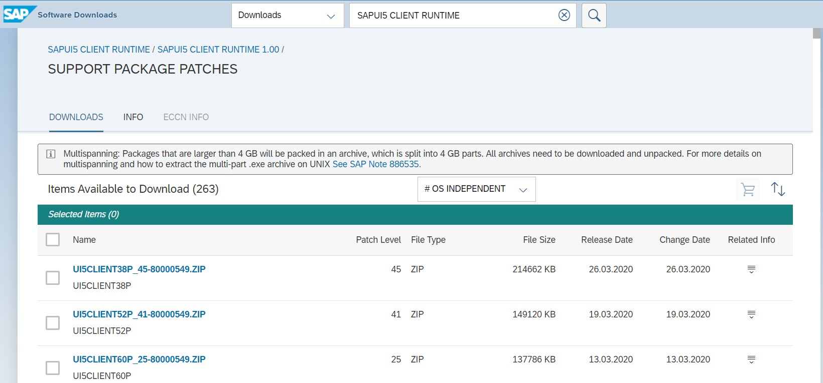
UI5 Runtime Package in Software downloads
www.anubhavtrainings.com

Slide 9
Custom Fiori App - Troubleshooting
Guidelines
A Custom Fiori App must have Component.js, manifest.json
One Fiori Project should have one OData Service
The namespace of our project must be unique
What breaks a Custom Fiori app after you deploy
All the Fiori Apps, the UI5 framework is the pre-requisite, We need to make sure that our version of UI5 in the SAP Server must support the version on which app is built on.
How to check version of SAPUI5 in our sap server. SICF→ ui5_ui5
[solution] We can upgrade the SAPUI5 version in SAP Server
Download the SAPUI5 RUNTIME CLIENT from sap service marketplace – S USER
Run Report to upload ZIP - /UI5/UI5_UPLOAD_PATCH_TO_MIME
When we have an app which is incorrectly implemented, Then the navigation will break. E.g. destroy method was missing in Component.js
Using the value of user defaults.
How to upload an App directly to the prod system to safeguard.
Control default launchpad parameters to control the launching of webgui apps and also default themes for user
/UI2/FLP_SYS_CONF
raj.shettyhyd@gmail.com
www.anubhavtrainings.com

Slide 10
Tools
Support Tools | Usages
F12 – Browser Console | Track network calls, Launchpad service
/UI2/BE also SLG1 | If the navigations from the launchpad to an application fails, the log is written in this tcode.
/iwfnd/error_log | Go and check all the issues related to our OData Service
SU53 | Authorization trace, if a tile is not visible or inside an app we have some error related to permission
/UI2/FLIA – Fiori Launchpad Intent Analysis | We can check all the available intents which are assigned to catalogs and their status, also we can see if an intent is assigned to a user through role
/UI2/FLC – Fiori Launchpad Checks | All the potential issues related to Tile, Catalog, Groups, Target mappings, intents and apps
Report - /UI5/APP_INDEX_CALCULATE | Use to check whether calculation of application index performed or not.
www.anubhavtrainings.com

Slide 11
Issues – Catalog and Group / Tile Errors
Issue | Reasons | Proposed Solution
A tile is displayed with an error “Cannot Load Tile” | The tile was deleted from the Catalog and it was referenced in the group. It’s a backend catalog and not yet replicated | You need to Replicate the backend catalogs. Delete the reference from the group from where we referred it.
A tile is not displayed | The tile has no matching target mapping. The tile is reference from standard content and the reference is broken. | Fiori launchpad Internet analysis and check for the target mapping - /UI2/FLIA Use Fiori Launchpad checks to find issues on missing/broken target mappings.
A group or catalog is not displayed | The catalog and group is not assigned to a PFCG Role | Use /UI2/FLPC
Intent Does not exist | Warning in the application log | Make sure that the intent referred to in url which exist
Tile is not visible to user, when we check role, the roles is assigned with the catalog | Until the tile is not added to group it will not appear by default | User need to go to app finder and search for it.
If the app is loading old version after an upgrade | Cache issue, app index was not calculated properly Half deployed app, due to transport | Run the report /UI2/APP_INDEX_CALCULATE Deploy /UI5/UI5_REPOSITORY_LOAD
During app deployment in BAS, we get an error called virus profile is not active |  | /IWFND/VIRUS_SCAN
www.anubhavtrainings.com

Slide 12
Issues – Catalog and Group
Issue | Reasons | Proposed Solution
Click on the Tile and it does not load | Target mapping has incorrect configuration | Check the App in SICF and node must be active
 | Underlaying OData service is failing | ST22, /IWFND/ERROR_LOG
 | App iss ue | Developer needs to investigate
https://help.sap.com/viewer/a7b390faab1140c087b8926571e942b7/7.51.4/en-US/5ea913a6ddb842e9afd6decb84261fcf.html
www.anubhavtrainings.com

Slide 13
Translation
Our users are using system from different countries hence in different languages and the content what we share needs to be translated in the different languages.
When the new system is installed, we need to install languages @ system level, SAP Provides language packages for your system which we can download from SAP Service market place and import in SAP Server. SMLT is the tcode to view all available translation packages.
Once the packages are installed, user cannot see the language dropdown on the launchpad login page, in order to see the language selection dropdown, we need to make settings. We also observe that the login screen for the launchpad has been a very old style, We want FIORI like logon screen – 1. Classical Fiori 2. Fiori 3
Go to SICF
Search for ushell and flp services
Go to error pages tab, system logon and click on configuration
Choose a custom Implementation class /UI2/CL_SRA_LOGIN OR /UI2/CL_FIORI3_LOGIN
Content Translation
Go to Translate option using App Manager tool
Translate using SE63
SE63 → Short Text → 00 → TABL → *WDY_CONF_USERT2*
Got to the tile titles and group titles, and provide texts in different language
Application messages will be translated in SE91
Maintain TEXTS table in ABAP for Data translation
www.anubhavtrainings.com

Slide 14
Theme Designer
In Companies, the brand consciousness is very important. When such a company buy SAP Solutions, they want their Fiori User Experience to work in alignment with their brand.
We need to change color, theme, tiles, applications, logo according to brand color.
We have SAP Theme designer which is free and available every where we have Fiori installed. Which can be designed to implement custom Themes.
Copy SAP Standard Theme and change it to adapt as per company branding.
/N/UI5/THEME_DESIGNER
www.anubhavtrainings.com

Slide 15

End of Day 23

Slide 16

Questions

Slide 17

Anubhav Oberoy

Slide 18

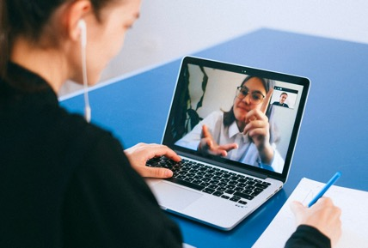
We’re committed to empower you to be
Most Desirable Resource
through powerful training solutions.
We build the workforce of the future.
250+
Corporate Clients
30,000+
Learners Trained
25000+
Learners Placed
FREE WEBINARS
Sign up for free webinars with industry experts every fortnight!
Enroll Now!
Contact us today!
https://anubhavtrainings.com/

Slide 19




More from AnubhavTrainings.com

Slide 20
Title
Content

